Slide 1
Apple Sentiment Analysis
Faraz Siddiqi
Github link: https://github.com/farazmsiddiqi/sentiment_analysis

Slide 2
The Dataset
Custom dataset regarding Apple’s controversial removal of the headphone jack in 2016 with the iPhone 7.
Dataset canvases Twitter’s reactions to this design decision
Dataset: https://www.kaggle.com/datasets/seriousran/appletwittersentimenttexts

Slide 3
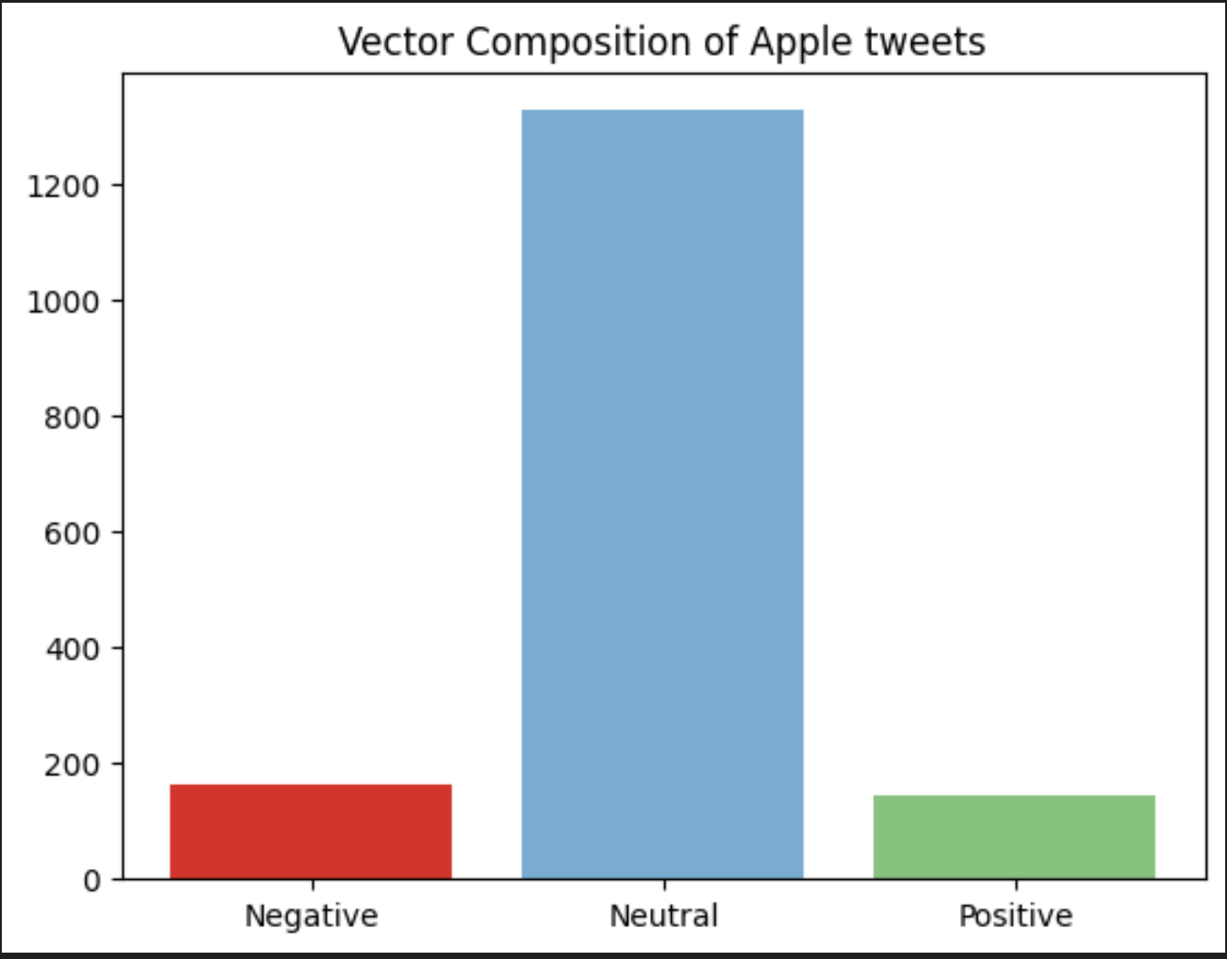
Interesting Discoveries
Vader (NLP library) shows a high amount of vector neutrality in the tweets.
Vector Composition = (NEGATIVE, NEUTRAL, POSITIVE, COMPOUND)
Sample: (-.0234, .765, .0111, -.0123)

Slide 4
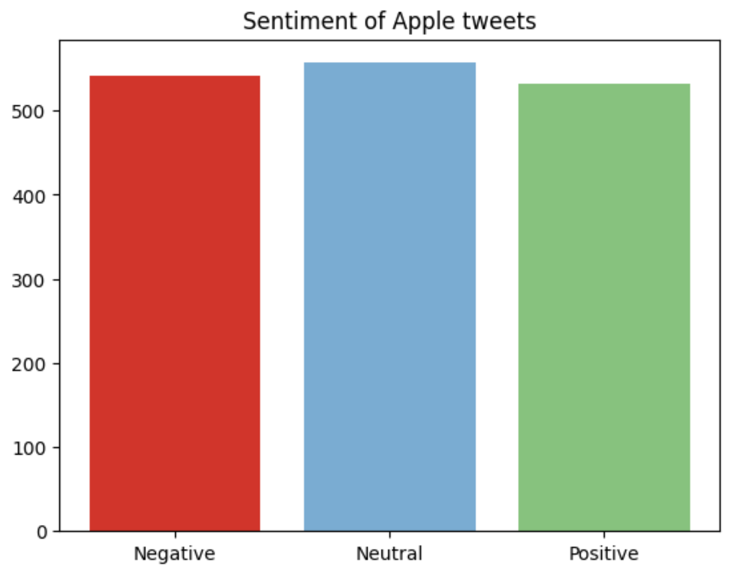
Interesting Discoveries
Discovery: close to equal amounts of angry, happy, and indifferent people.
Negative: 541 ppl, Neutral: 557 ppl, Positive: 532 ppl
This is bad. A product launch should illicit a majority of positive responses in the (polarized) community.

Slide 5
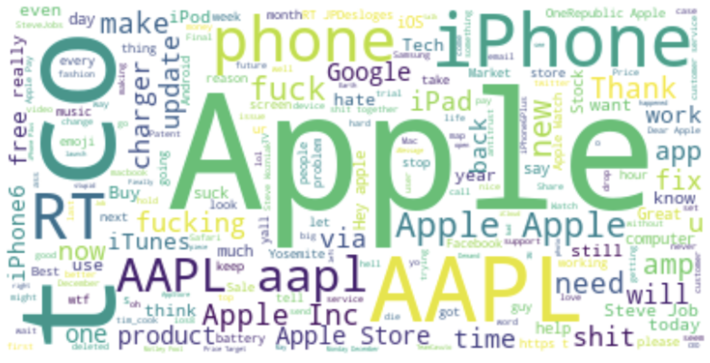
Interesting Discoveries
The most talked about topic in the apple twitter feed was………. apple.
Notice the word “charger”. The new design decision had people talking!
BAD WORD
BAD WORD
BAD WORD

Slide 6
Application
Insight #1: People are not responding well to the release of your new iPhone. There are an abnormal amount of negative reviews compared to previous data.
Insight #2: People are talking about the removal of the headphone jack on the iPhone in a negative context. This may be because you have restricted their ability to listen to music/audio. I would recommend providing compatible headphones.

